Slide 1

SORA 2.5 for Emergency BVLOS SUA Operations between Tseung Kwun O Hospital and Sai Kung Area
Group 4
Ziyi Huang 25052005g
Peijun Zhao 25093525g
Zongru Fu 25098984g
Xiaohan Wang 25047428g
Daizhe Wu 25039582g
Hao Wang 25117594g
Jiaming Sun 25043507g
Zhongtian Xie 25041039g
Yixuan Yan 25107505g
Yuwen Zeng 25050497g
(Arranged in order of presentation)

Slide 2
Part I
Project Background
Ziyi Huang 25052005g

Slide 3

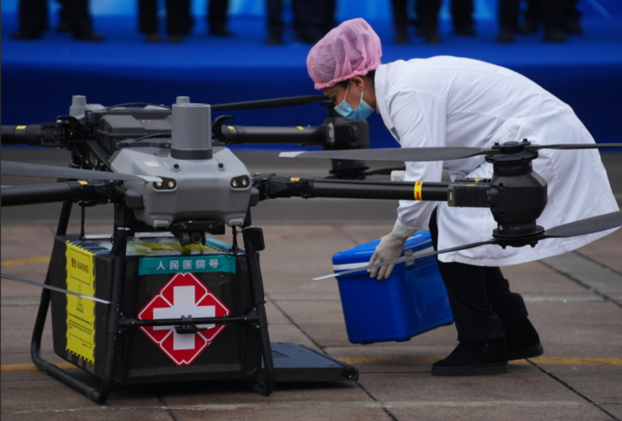
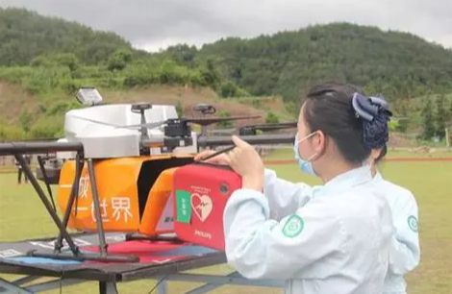
Value of the project
Saving Lives with Drones: A Next-Gen Emergency Response Solution
Challenge: “Golden rescue window” for cardiac arrest
Solution: Utilizing drone drones for emergency AED delivery.
Core Value: Reducing delivery time from “tens of minutes” to “approximately 10 minutes”
Drone delivery of medical supplies in Wulumuqi
Drone carrying AED create an emergency air corridor in Zhejiang
Notes:
The “golden rescue window” for cardiac arrest lasts only minutes, yet traditional ground transportation faces significant challenges in congested or remote areas.

Slide 4
What & How
Understand the basic background (no-fly zone etc.)
Determine the drone type
Confirm the flying route
Follow the SORA procedure

Slide 5
Outcome
SORA:
Define operational scenarios
Assess inherent risks on the ground and in the air
Apply mitigation measures to reduce risk levels
Determine the final safety assurance level
Ground Risk Class(GRC) = 2
Air Risk Class(ARC) = B
Specific Assurance and Integrity Levels(SAIL) = II

Slide 6
Part II
Operation Concept
Peijun Zhao 25093525g
Zongru Fu 25098984g

Slide 7
1.1 Mission Workflow
01
Receive emergency request and launch SUA from hospital
02
Transport AED in BVLOS mode to incident site
03
Land and deploy AED for retrieval by ground personnel
04
Return SUA to hospital after delivery

Slide 8

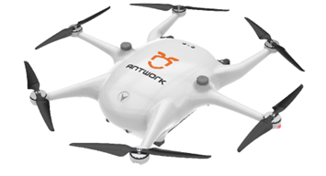
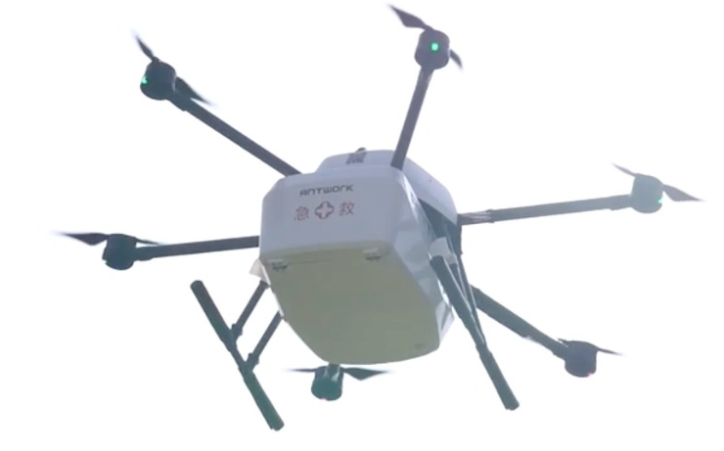
1.2 SUA Selection & Payload
Selected Model: Antwork RA3
Flight Performance
Max Range: 18 km
Cruise Speed: 60–72 km/h
One-Way Delivery: ~10 minutes
Payload Capacity
4 kg payload capacity
Standard AED: 1.5–2.5 kg
Vibration damping & warning light included
Proven Medical Experience
Successfully deployed in emergency blood delivery operations in Hangzhou
Provides valuable real-world reference for AED transport missions
Figure 1 Antwork RA3
Source: https://www.antwork.link/

Slide 9
1.3 Safety & Route Restrictions
Safety Features:
Six-rotor redundant power system：
·It can maintain flight even in the event of a single rotor failure.
BVLOS emergency protocols:
·Motor failure: Safe-zone landing
·Link loss: Automated return
Operational Limits:
·Max wind speed: 10 m/s
·No-fly zone compliance
·Pre-surveyed obstacle avoidance routes

Slide 10
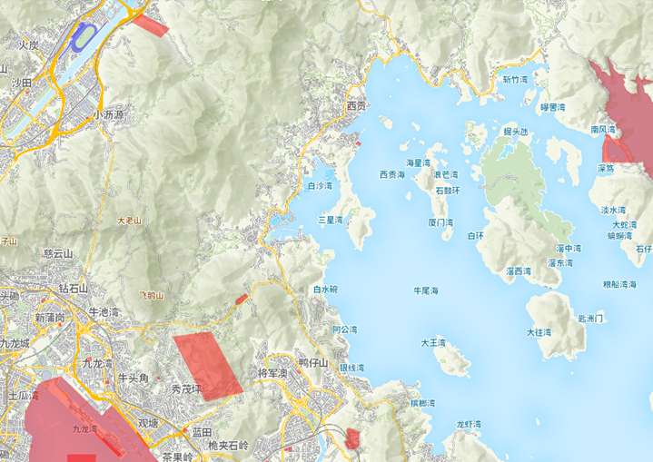
1.4 SUA No-Fly Zone
The diagram shows the SUA no-fly zone in Tseung Kwan O - Sai Kung and the surrounding areas.
No fly zone in Hongkong (Scale: 1:2 km)
Source: https://esua.cad.gov.hk/web/droneMap?lang=en_US

Slide 11
2.1 Intrinsic Ground Risk Class (IGRC)
It is an important indicator for assessing the potential risks of drones to ground personnel and property, and its core parameter is population density

Slide 12
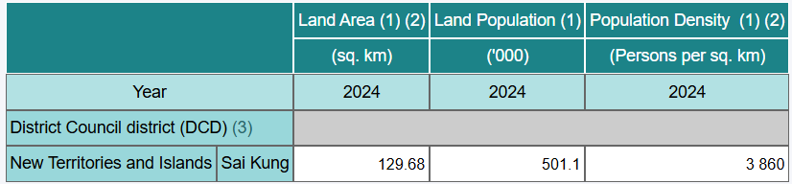
2.1 Intrinsic Ground Risk Class (IGRC)
Sai Kung popluation density : 3860 people per square kilometer
Tseung Kwan O : a total area is 1,080 hectares and the population is approximately 257,000.
Tseung Kwan O ：over 20,000 people per square kilometer.
IGRC：5~6
https://baike.baidu.com/item/%E5%B0%86%E5%86%9B%E6%BE%B3/2293635

Slide 13
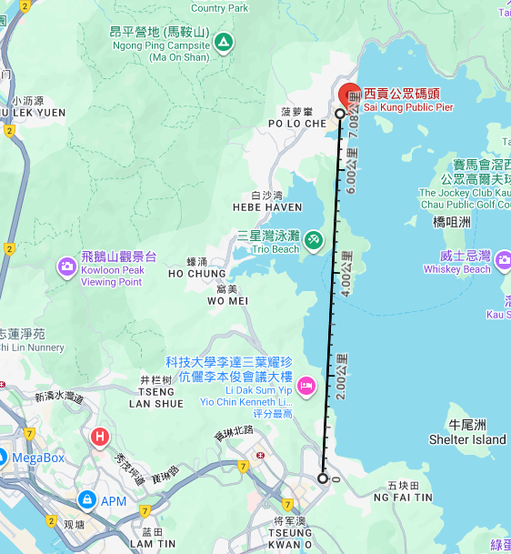
2.2The Air Risk Class (ARC)
Flight path is not in the immediate vicinity of a major airport
The air traffic density in this airspace is assessed to be low to medium
Air Risk Class (ARC):C
Straight distance of around 7 km
Source: https://www.google.com/maps

Slide 14
Part III
Ground Risk Assessment
Xiaohan Wang 25047428g
Daizhe Wu 25039582g

Slide 15
3.1 Purpose and Scope
01
BVLOS AED delivery: Tseung Kwan O Hospital → Sai Kung Pier (~7 km)
02
Framework: JARUS SORA v2.5, Steps 4.2 & 4.3
03
Aircraft: Antwork RA3 (<25 kg, 13 m/s, redundant 6-rotor design)
04
Purpose: Evaluate risks to people/property under Hong Kong CAD (Cap 448G)
Low Robustness Level

Slide 16
3.2 Determining the Intrinsic Ground Risk
7 km BVLOS corridor below 400 ft AGL
Flight geography: mainly coastal + sparse land
iGRC = 6 (moderate)
Weighted population density < 5 000 people/km² (suburban category)
iGRC calculation based on CD ≈ 3 m and Vₘₐₓ ≤ 25 m/s

Slide 17
3.3 Mitigation Measures and Final GRC
Mitigation | Implementation | Reduction
M1(A) Sheltering | Over-water & mountain route | –2
M1(B) Operational limits | Daylight / winds < 10 m/s | –1
M1(C) Ground observers | Controlled launch & landing zones | –1
Fail-safe design | Redundant motors + Auto-RTH / parachute | –1 (Optional)
→ Final GRC ≈ 2 (Acceptable level)

Slide 18
3.4 Ground Risk Buffer and Contingency Procedures
Simplified 1:1 rule: H<sub>CV</sub> = 91.4 m, CD = 3 m → S<sub>GRB</sub> ≈ 93 m per side
Ballistic method → ≈ 58 m (per side) → conservative value adopted = 93 m
Pre-surveyed safe zones: parks, sports fields, coastal areas
Contingency protocols:
Internal failures → controlled descent
External failures → RTH to hospital
Weather > 10 m/s → abort
Manual override via radio link

Slide 19
3.5 Findings and Compliance
iGRC = 6 (moderate intrinsic risk)
Mitigations → Final GRC = 2 (low acceptable risk)
Ground Risk Buffer ≈ 93 m per side
Complies with HK CAD SUA Order Cap 448G / AC-013
Supports safe BVLOS emergency missions

Slide 20
Part IV
Air Risk Assessment
Hao Wang 25117594g
Jiaming Sun 25043507g
Zhongtian Xie 25041039g

Slide 21
4.1 Initial ARC determination (Step 4)
Vertical limits for operating volume
Background and Regulations：
According to documentation and Hong Kong relevant rules (HKSAR SUV Order (Cap448G)), the maximum flight altitude for BVLOS is 300 feet AGL (approximately 91.44 meters); In conjunction with common mission scenarios such as photography and surveying, the operational volume vertical range is typically set as "ground to 91.44 m AGL", with a reserved vertical emergency volume, and the final vertical limit must not exceed the 300-foot cap.

Slide 22
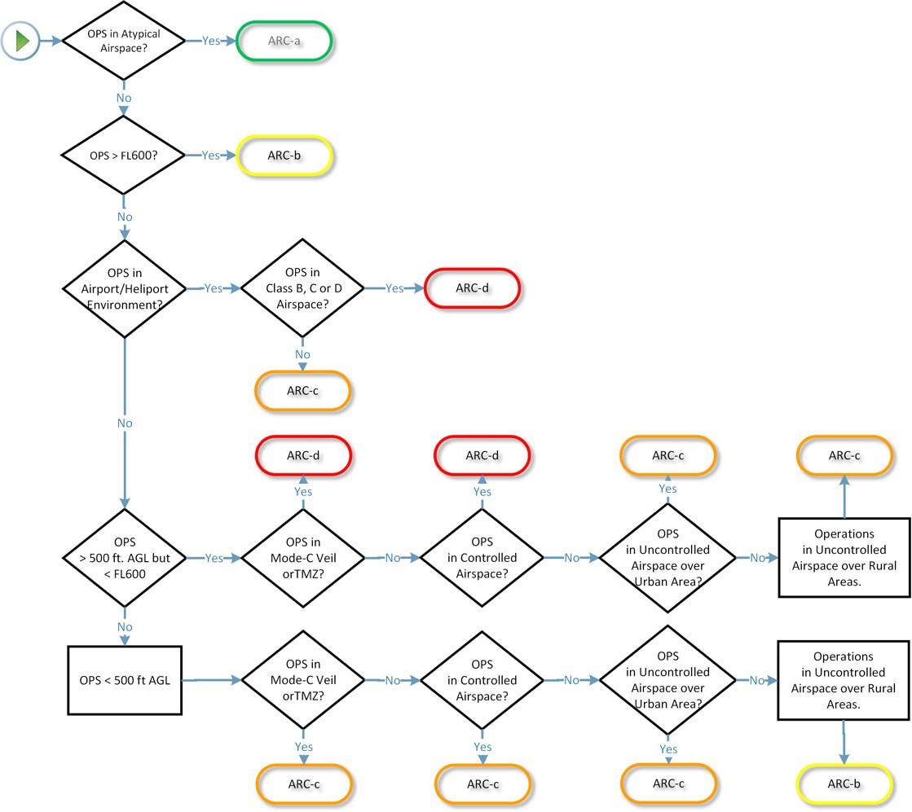
4.1 Initial ARC determination (Step 4)
Use the decision tree in Figure 6 to determine the initial ARC

Slide 23
4.1 Initial ARC determination (Step 4)
Step by step according to the decision tree steps shown below:
First determine if it is "atypical airspace operation" → No
Determine whether the operating altitude is > FL600 (about 18,288 meters) → No
Determine whether it is in "B, C, D category controlled airspace" or "airport/helipad environment" → No
Conclusion: The initial ARC is
ARC-C
Ultimately determine "unregulated airspace and altitude < 500 feet AGL, operating area rural/suburban" → yes
Determine if it is in "unregulated airspace and altitude > 500 feet AGL (about 152.4 meters)" → No

Slide 24
4.1 Initial ARC determination (Step 4)
Airspace Environment Analysis
Unregulated airspace: This operating route is entirely within the G-class unregulated airspace designated by Hong Kong. Flying in this airspace does not require an air traffic control permit, and remote pilots are responsible for their own separation from other aircraft, which conforms to SORA's definition of "unregulated airspace”
Non-airport environment: Route planning has actively avoided all airport traffic zones and major heliports. The operating area is tens of kilometers away from major facilities such as Hong Kong International Airport and Shek Kong Airport and is not within the scope of any "airport environment". Therefore, it is determined to be a non-airport environment.
Located above the city: The starting point of the operation and key flight segments pass through the high-density urban area of Tseung Kwan O. Although subsequent segments may pass through Sai Kung country, the airspace environment for the entire operation should be determined based on the riskiest part in accordance with the strictest principles of SORA risk assessment. Therefore, the operation was determined to be carried out over the city.

Slide 25
4.2 TMPR determination (Step 5)
Application of Strategic Mitigations to Determine Residual ARC
Purpose：According to the document logic, the TMPR grade of the BVLOS operation should be determined in combination with "residual ARC“
Methodology (Annex C Framework): The process follows the two-step methodology outlined in SORA Annex C section 6:
1. Identify Initial ARC based on airspace and environmental density (Table 4).
2. Including operational restrictions (section 6.2) and general structures and rules (section 6.3), to demonstrate that the "Encounter Density" in the local operating environment is equivalent to a lower AEC level, thereby achieving a reduction in ARC with approval from regulatory authorities.

Slide 26
4.2 TMPR determination (Step 5)
Application of Strategic Mitigations to Determine Residual ARC
Operational Environment, AEC and ARC.
Operations in; | Initial Generalized Density Rating | Corresponding AEC | Initial ARC
Airport/Heliport Environment
OPS in Airport/Heliport Environment in Class B, C or D airspace |  | AEC 1 | ARC-d
OPS in Airport/Heliport Environment in Class E airspace or in Class F or G | 3 | AEC 6 | ARC-c
Operations above 500 feet AGL but below Flight level 600
OPS >500ft AGL but <FL600 in a Mode-S Veil or Transponder Mandatory Zone (TMZ) | 5 | AEC 2 | ARC-d
OPS >500ft AGL but <FL600 in controlled airspace | 5 | AEC 3 | ARC-d
OPS >500ft AGL but <FL600 in uncontrolled airspace over Urban Area | 3 | AEC 4 | ARC-c
OPS >500ft AGL but <FL600 in uncontrolled airspace over Rural Area | 2 | AEC 5 | ARC-c
Operations below 500 ft AGL
OPS <500ft AGL in a Mode-S Veil or Transponder Mandatory Zone (TMZ) | 3 | AEC 7 | ARC-c
OPS <500ft AGL in controlled airspace | 3 | AEC 8 | ARC-c
OPS <500ft AGL in uncontrolled airspace over Urban Area | 2 | AEC 9 | ARC-c
OPS <500ft AGL in uncontrolled airspace over Rural Area | 1 | AEC 10 | ARC-b
Operations above Flight Level 600
OPS >FL600 | 1 | AEC 11 | ARC-b
Operations in Atypical or Segregated Airspace
OPS in Atypical/Segregated Airspace | 1 | AEC 12 | ARC-a
Table 4: AEC Mapping

Slide 27
4.2 TMPR determination (Step 5)
Operational Overview for Mitigation Assessment
Airspace Class: Class G unregulated airspace (under Cap 448G).
Altitude: ≤ 300 ft AGL within VLL volume.
Route Length: ≈ 7 km coastal corridor between Tseung Kwan O Hospital and Sai Kung Pier.
Exposure Area: ≈ 70 % over water or sparsely populated terrain, ≈ 30 % urban terminal segments.
Other Traffic: No scheduled aerodrome or controlled helicopter routes within 2 km.
Operation Type: Emergency AED delivery (occasional BVLOS medical mission).

Slide 28
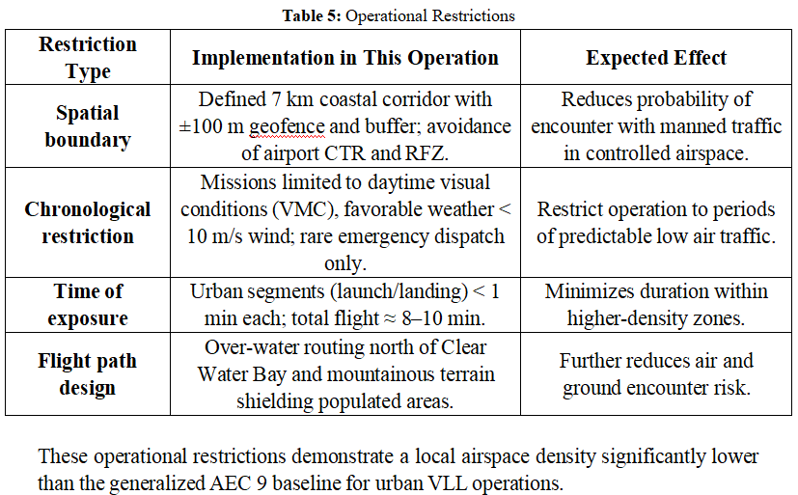
4.2 TMPR determination (Step 5)
Strategic Mitigation by Operational Restrictions

Slide 29
4.2 TMPR determination (Step 5)
Strategic Mitigation by Common Structures and Rules：
Within VLL (Class G) airspace, the operation complies with existing UAS regulations and coordination procedures providing an additional single-level ARC reduction
Flight notification and coordination: Prior submission to CAD/ANSP via UTM system.
Electronic conspicuity: Remote ID broadcast and high-intensity strobe lights ensure visibility to other air users.
Compliance with VLL rules: Adherence to Cap 448G and visual conspicuity requirements for SUA operations < 400 ft AGL.
Communication: Ground control maintains real-time link and monitoring; emergency contact with CAD if needed.

Slide 30
4.2 TMPR determination (Step 5)
Residual ARC Determination
Initial ARC: ARC-C.
Mitigations applied: Comprehensive operational restrictions + conformance with common VLL rules.
Evidence of low density: Over-water routing, short urban exposure, UTM coordination, absence of helicopter routes.
Residual classification: Under Table 2 of Annex C, when an AEC 9 operation demonstrates local density ≈ AEC 10 and meets rule-based mitigations, the ARC may be reduced from C → B. The competent authority retains final approval of this classification.
Residual ARC = B.

Slide 31
4.2 TMPR determination (Step 5)
Supporting Evidence and Verification
Flight planning documents: KML route, no-fly zones map, airspace classification chart.
UTM coordination record: proof of flight plan submission and acknowledgement
Geofencing log: ±100 m corridor containment data.
NOTAM review: no conflicting operations during mission period.
Remote ID recording: showing continuous broadcast during flight.

Slide 32
4.3 Conclusion
Applying strategic mitigations in accordance with SORA Annex C significantly reduces the encounter probability within the defined operational volume. The integration of spatial, temporal, and rule-based measures demonstrates that the operation’s actual air risk is equivalent to that of a lower-density VLL environment (AEC 10).
Consequently, the Residual ARC for the AED delivery mission between Tseung Kwan O Hospital and Sai Kung Public Pier is assessed as ARC-B, subject to competent authority endorsement.

Slide 33
4.4 Application of Strategic Mitigations to Determine Residual ARC (step 6)
Purpose
Based on the definition in Appendix C of SORA v2.5, the step applies strategic mitigation measures to demonstrate that the probability of encountering a manned aircraft in this operational environment is lower than the general baseline scenario, based on the initial air risk level (Initial ARC=C) determined in the previous stage, thereby reducing the risk to a lower residual air risk level (Residual ARC).
Methodology (Annex C Framework)
The process follows the two-step methodology outlined in SORA Annex C section 6:
Identify Initial ARC based on airspace and environmental density (Table 4).
Including operational restrictions (section 6.2) and general structures and rules (section 6.3), to demonstrate that the "Encounter Density" in the local operating environment is equivalent to a lower AEC level, thereby achieving a reduction in ARC with approval from regulatory authorities

Slide 34
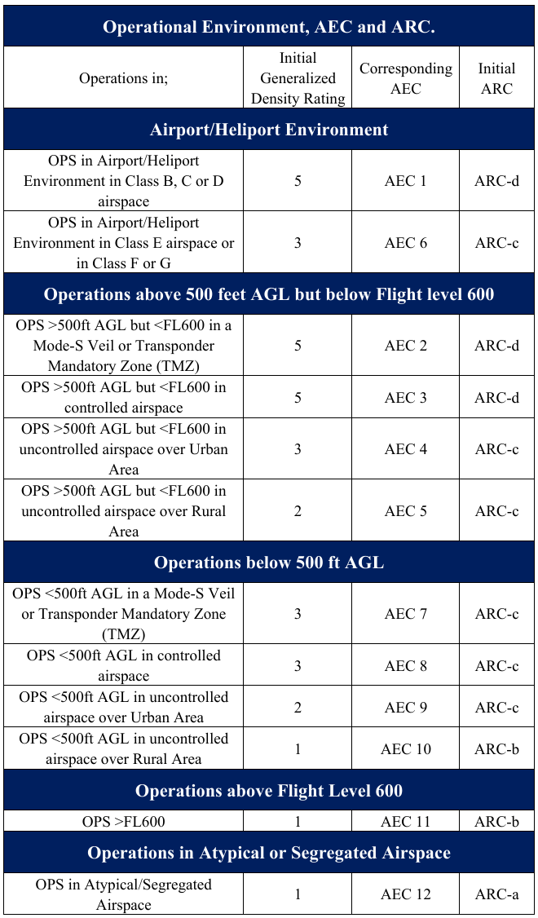
4.5 Methodology (Annex C Framework)
Table 1: AEC Mapping

Slide 35
4.6 Operational Overview for Mitigation Assessment
Operational Overview for Mitigation Assessment
Airspace Class: Class G unregulated airspace (under Cap 448G).
Altitude: ≤ 300 ft AGL within VLL volume.
Route Length: ≈ 7 km coastal corridor between Tseung Kwan O Hospital and Sai Kung Pier.
Exposure Area: ≈ 70 % over water or sparsely populated terrain, ≈ 30 % urban terminal segments.
Other Traffic: No scheduled aerodrome or controlled helicopter routes within 2 km.
Operation Type: Emergency AED delivery (occasional BVLOS medical mission).

Slide 36
4.7 Strategic Mitigation by Operational Restrictions
These operational restrictions demonstrate a local airspace density significantly lower than the generalized AEC 9 baseline for urban VLL operations.
Restriction Type | Implementation in This Operation | Expected Effect
Spatial boundary | Defined 7 km coastal corridor with ±100 m geofence and buffer; avoidance of airport CTR and RFZ. | Reduces probability of encounter with manned traffic in controlled airspace.
Chronological restriction | Missions limited to daytime visual conditions (VMC), favorable weather < 10 m/s wind; rare emergency dispatch only. | Restrict operation to periods of predictable low air traffic.
Time of exposure | Urban segments (launch/landing) < 1 min each; total flight ≈ 8–10 min. | Minimizes duration within higher-density zones.
Flight path design | Over-water routing north of Clear Water Bay and mountainous terrain shielding populated areas. | Further reduces air and ground encounter risk.
Table 2: Operational Restrictions

Slide 37
4.8 Strategic Mitigation and Rules & Residual ARC Determination
Strategic Mitigation by Common Structures and Rules
Within VLL (Class G) airspace, the operation complies with existing UAS regulations and coordination procedures providing an additional single-level ARC reduction:
Flight notification and coordination: Prior submission to CAD/ANSP via UTM system.
Electronic conspicuity: Remote ID broadcast and high-intensity strobe lights ensure visibility to other air users.
Compliance with VLL rules: Adherence to Cap 448G and visual conspicuity requirements for SUA operations < 400 ft AGL.
Communication: Ground control maintains real-time link and monitoring; emergency contact with CAD if needed.
Residual ARC Determination
Initial ARC: ARC-C.
Mitigations applied: Comprehensive operational restrictions + conformance with common VLL rules.
Evidence of low density: Over-water routing, short urban exposure, UTM coordination, absence of helicopter routes.
Residual classification: Under Table 2 of Annex C, when an AEC 9 operation demonstrates local density ≈ AEC 10 and meets rule-based mitigations, the ARC may be reduced from C → B. The competent authority retains final approval of this classification.
Residual ARC = B

Slide 38
4.9 Supporting Evidence and Verification
Supporting Evidence and Verification
Flight planning documents: KML route, no-fly zones map, airspace classification chart.
UTM coordination record: proof of flight plan submission and acknowledgement.
Geofencing log: ±100 m corridor containment data.
NOTAM review: no conflicting operations during mission period.
Remote ID recording: showing continuous broadcast during flight.
Conclusion
Applying strategic mitigations in accordance with SORA Annex C significantly reduces the encounter probability within the defined operational volume. The integration of spatial, temporal, and rule-based measures demonstrates that the operation’s actual air risk is equivalent to that of a lower-density VLL environment (AEC 10). Consequently, the Residual ARC for the AED delivery mission between Tseung Kwan O Hospital and Sai Kung Public Pier is assessed as ARC-B, subject to competent authority endorsement.

Slide 39
Part V
SAIL Level Identification
Jiaming Sun 25043507g

Slide 40
5.1 SAIL Level Identification
According to Table 7 of the SORA 2.5 framework, with a Final GRC of 1 and Residual ARC of b, the operation is classified as SAIL II. This low-risk category requires only basic robustness in organizational, technical, and operational areas. Operators must establish an SMF and SOPs, ensure personnel are properly qualified, and maintain verifiable safety records. No third-party assessment is required, but compliance must be demonstrable to authorities.
SAIL Determination
 | Residual ARC
Final GRC | a | b | c | d
≤2 | I | II | IV | VI
3 | II | II | IV | VI
4 | III | III | IV | VI
5 | IV | IV | IV | VI
6 | V | V | V | VI
7 | VI | VI | VI | VI
>7 | Category C (Certified) operation

Slide 41
5.2 Implications of SAIL II
(1) Organizational Level
Establish a basic Safety Management Framework (SMF) defining safety roles and risk control.
Appoint a Safety Focal Point to maintain the Risk Register and training records.
(2) Technical Level
Ensure basic system redundancy, geofencing, and Return-to-Home (RTH) functions.
Test critical safety features internally under expected operational conditions.
(3) Operational Level
Develop mission-specific SOPs and conduct simple pre-flight risk assessments.
Record and review anomalies; perform regular internal safety reviews.
(4) Impact on OSO
Meet Basic Robustness requirements; third-party certification not required.
Demonstrate compliance through clear documentation and consistent implementation.

Slide 42
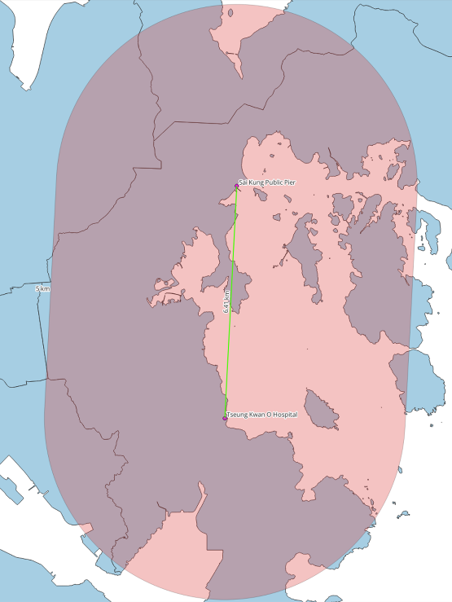
5.3 Adjacent Area Assessment
Adjacent Area Determination (SORA 2.5)
Adjacent Area: Region the drone can reach within 3 minutes after loss of control.
For Antwork RA3 (max speed 50 km/h): → 50 km/h × 0.05 h = 2.5 km → Radius ≈ 5 km
Population Density (Hong Kong Route)
Departure (Tseung Kwan O Hospital): 20,000–25,000 persons/km²
Mid-route: <3,000 persons/km²
Arrival (Sai Kung Pier): ~10,000 persons/km²
Weighted average: ~3,000 persons/km² → Low-to-medium density risk zone
Schematic diagram of flight routes and adjacent areas
Source: https://www.google.com/maps

Slide 43
5.4 Containment Robustness Level
According to Tables 8–13 of SORA 2.5, and in alignment with the requirements of SAIL II, the containment requirement of the route is low.
Containment Type | Robust Level | Primary Measures
Technical Containment | Low (Basic Robustness) | Geofencing, Single-Link Communication, RTH, Visual Line-of-Sight Backup
Operational Containment | Low (Basic Robustness) | Standard operating procedures (SOPs), pre- Pre-Flight Risk Assessment, Post-Flight Data Review and Logging, Weather Constraints

Slide 44
5.5 Technical Measures
Safety Measure | Description
GNSS Geofencing | Establishes a 50 m horizontal geofence corridor along the mission route using GNSS. If the aircraft approaches or crosses the boundary, the ground control station triggers sound and light alarms. If deviation continues, the system automatically executes the Return-to-Home (RTH) procedure to maintain control.
Single Link Communication with Health Monitoring | Uses a single-frequency control link (2.4G / 5.8G) with real-time signal strength monitoring. When signal attenuation or interruption is detected, the system automatically executes hover or RTH procedures to maintain safe control.
Automatic RTH and Emergency Landing | In case of communication loss, low battery, or navigation anomaly, the aircraft automatically performs RTH or emergency landing. Landing points are prioritized in low-risk areas (e.g., parking lots, beaches, sports fields).
Basic Health Monitoring | The flight control system continuously monitors key parameters (battery level, GPS signal, communication link). Upon detecting abnormal values, the ground control station issues an immediate alarm, allowing the operator to take timely corrective actions.
Visual Line of Sight Backup | A Visual Observer (VO) assists in monitoring the operational environment and detecting potential hazards around the flight path, especially during takeoff and landing, providing additional safety assurance.

Slide 45
5.6 Operational Measures
Operational Measure | Description
SOPs and Mission Planning | All missions follow established Standard Operating Procedures (SOPs), covering mission planning, takeoff/landing sequences, emergency actions, and post-flight reviews. Routes must be selected within low-risk corridors (e.g., coastal or sparsely populated areas) to minimize third-party exposure.
Pre-Flight Risk Assessment | Before each mission, a simple risk assessment must evaluate weather conditions, airspace status, equipment readiness, and population distribution along the route. If potential risks are identified, operational constraints or modified procedures must be applied.
Weather and Environmental Constraints | Operations are limited to weather conditions with wind speeds ≤10 m/s and visibility ≥3 km. Flights must be suspended during rain, strong gusts, or poor visibility to prevent navigation and control degradation.
Personnel Competence and VO Support | Pilots and Visual Observers (VOs) must receive internal training on communication loss, emergency landing, and RTH procedures. VOs must continuously monitor airspace during flight, providing additional safety assurance for BVLOS operations.
Post-Flight Data Review and Logging | After each mission, flight logs, telemetry data, and anomaly reports must be reviewed to ensure safety and performance. All related records must be stored for a minimum of 30 days for internal safety review and traceability.

Slide 46
5.7 Operational Limitations
Restriction Type | Description
Population Density Restriction | BVLOS operations must be suspended if a continuous high-density area (≥10,000 persons/km²) exists within the 3.6 km Adjacent Area and cannot be safely avoided.
Public Gathering Restriction | If large-scale public events (e.g., festivals, concerts, marathons) occur and containment margins are insufficient, the mission must be rerouted or postponed.
Airspace and Meteorological Restriction | Operations must be immediately suspended during typhoons, thunderstorms, low visibility conditions, or when government flight restriction directives are issued.
Night Operation Restriction | Night operations are permitted only if adequate lighting and visual conditions are available. Ground observers must maintain continuous visual confirmation of the aircraft.

Slide 47
5.8 Conclusion
The assessment result shows that, with the condition of Final GRC = 1 and Residual ARC = b, Specific Assurance and Integrity Level of the project operation is SAIL II and the target is to achieve Basic Containment Robustness with basic technical and procedural measures.
With the support of GNSS-based geofencing, single link communication with health monitoring, automatic RTH, basic system health check and SOPs, any deviation or malfunction shall be confined in a pre-defined and controllable volume.
It can maintain the safety of third party on the ground in an acceptable limit of containment margin and provides sufficient basis for the OSO framework in Step 9, which is in line with the assurance requirement of SAIL Level II operation.

Slide 48
Part VI
Operational Safety Objectives
Yixuan Yan 25107505g

Slide 49
6.1 Operational Safety Objectives
Core Premise
SAIL Ⅱ
Low Robustness Level

Slide 50
6.1 Operational Safety Objectives
Compliance Analysis
OSO#01 Ensure the Operator is competent and/or proven
Robustness Level: Low (L)
Operator masters Antwork RA3 features and compiles operational procedure documents.
Dedicated Safety Focal Point manages risk registers and training records; airworthiness/design monitoring records retained.

Slide 51
6.1 Operational Safety Objectives
Compliance Analysis
OSO#03 UAS maintained by competent and/or proven entity
Robustness Level: Low (L)
Follows manufacturer-aligned maintenance instructions; full records of maintenance activities kept.
Authorized maintenance personnel list and training records maintained.
OSO#06 C3 link characteristics (e.g., performance, spectrum use) are appropriate for the operation
Robustness Level: Low (L)
For the Antwork RA3, the C3 link, which includes the C2 link and mission data transmission link, adopts the unlicensed frequency bands of 2.4 GHz and 5.8 GHz, meets the required performance standards, complies with the requirements of HKCA 1039 (Issue 7, 2024).
OSO#07 Conformity check of the UAS configuration
Robustness Level: Low (L)
Periodic checks verify payload ≤4kg and correct geofencing; trained staff self-declare status.
Special checks after payload changes/system upgrades.

Slide 52
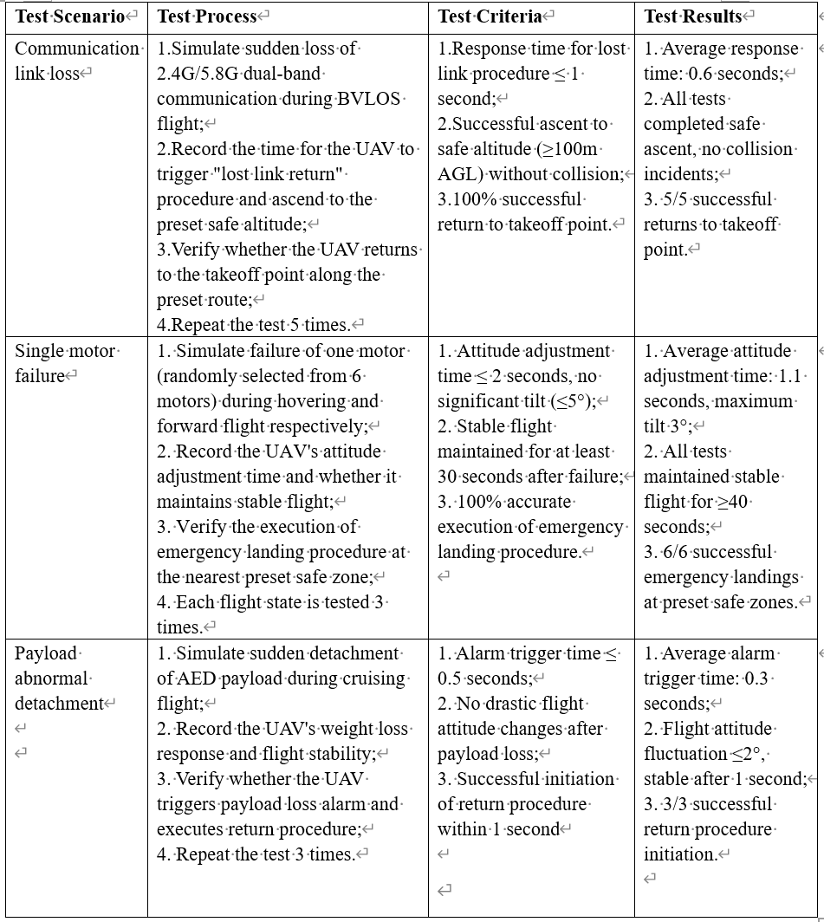
6.1 Operational Safety Objectives
Compliance Analysis
OSO#08 Operational procedures are defined, validated and adhered to
Robustness Level: Medium (M)
Comprehensive Standard Operating Procedures have been established，covering flight planning，pre/post-flight inspections,emergency procedures.
The emergency test records retained

Slide 53
6.1 Operational Safety Objectives
Compliance Analysis
OSO#09 Remote crew trained and current
Robustness Level: Low (L)
Theoretical and practical training plans have been formulated.
Training/assessment/recertification records retained
OSO #13 External services supporting UAS operations are adequate to the operation
Robustness Level: Low (L)
A Service Level Agreement has been signed with the UTM service provider to ensure real-time air traffic data updates and conflict alerts, with clear roles and responsibilities defined.
OSO#16 Multi crew coordination
Robustness Level: Low (L)
Coordination procedures between the remote pilot and Visual Observer have been established, including real-time airspace condition reporting, emergency situation notification, and standard communication phraseology.
OSO#17 Remote crew is fit to operate
Robustness Level: Low (L)
Pre-mission health self-declarations; drug/alcohol prohibited; duty ≤8hrs/day.
Random tests conducted; failures result in immediate suspension.

Slide 54
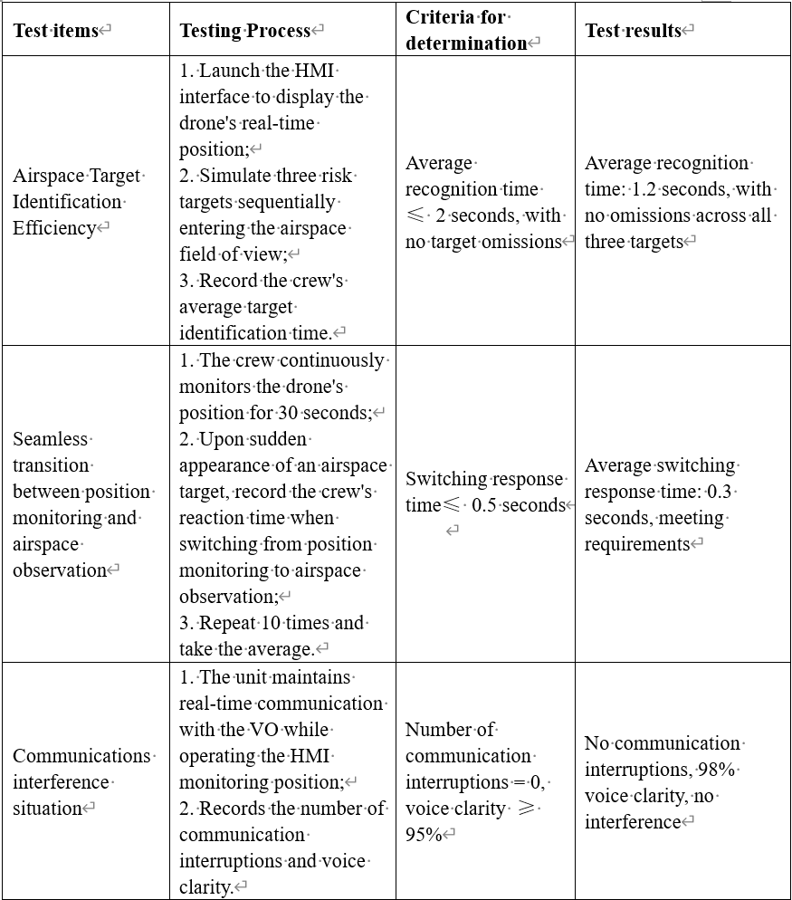
6.1 Operational Safety Objectives
Compliance Analysis
OSO#20 A Human Factors evaluation has been performed and the Human-Machine Interface (HMI) found appropriate for the mission
Robustness Level: Low (L)
HMI evaluated as intuitive, error-free; tests verify target identification/state switching efficiency.
Supports position monitoring without compromising airspace scanning/communication.
OSO#23 Environmental conditions for safe operations defined, measurable and adhered to
Robustness Level: Low (L)
Operational limits: Beaufort ≤6 winds, moderate rain/snow; pre-flight evaluation using HK Observatory data.
Flights suspended if conditions exceed limits; records retained.

Slide 55
Part VII
Comprehensive Safety Portfolio
Yuwen Zeng 25050497g

Slide 56
7.1 Comprehensive Safety Portfolio
Ground Risk Assessment Results
Step #1 Operations manual
#1.1 | Description of proposed operation including the locations | BVLOS emergency AED delivery from Tseung Kwan Hospital to Sai Kung Public Pier. Route primarily over coastal waters and sparsely populated areas.
#1.2 | Dimensions of the operational volume and the adjacent volume (Rounded up to first decimal place) | Height of the flight geography Height of the contingency volume Width of the contingency volume Width of the ground risk buffer | HFGmax HCVmax SCVmax SGRBmax | 91 m 91 m 100m 93m
 |  | Height of the adjacent volume Width of the adjacent volume | HAV SAV | 91m 2500m
Step #2 UAS intrinsic ground risk class
#2.1 | Type of operational areas on the ground (including flight geography, contingency volume and ground risk buffer) | ☐ Controlled ground area ☐< 5 People/km2 (remote) ☐< 50 People/km2 (lightly populated) ☐< 500 People/km2 (sparsely populated) ☑< 5000 People/km2 (suburban/low density metropolitan) ☐< 50.000 People/km2 (high density metropolitan) ☐> 50.000 People/km2 (assemblies of people)
#2.2 | Specify the intrinsic ground risk class | iGRC=6
Step #3 Final ground risk class determination
#3.1 | Specify the applied ground risk mitigations (if applicable) | M1 (A) strategic mitigation - sheltering Specify the level of robustness:
 |  | ☐None | ☐Medium | ☑High
 |  | M1 (B) strategic mitigation – operational restrictions Specify the level of robustness:
 |  | ☐None | ☑Medium | ☐High
 |  | M1 (C) tactical mitigation – ground observation Specify the level of robustness:
 |  | ☐None | ☑Low
 |  | M2 Effects on UA impact dynamics are reduced Specify the level of robustness:
 |  | ☐None | ☑Medium | ☐High
#3.2 | Specify the final ground risk class | Final GRC = 2
Final Ground Risk Class: 2

Slide 57
7.1 Comprehensive Safety Portfolio
Air Risk Assessment Results
Step #4 Initial air risk class
#4.1 | Classification of the airspace where the operation is intended to be conducted (multiple answers possible) | ☐A ☐B ☐C ☐D ☐E ☐F ☑G
 |  | ☐Restricted area (ED-R) | ☐Danger area (ED-D)
 |  | ☐TMZ | ☐RMZ | ☐ATZ
#4.2 | Specify the initial air risk class and the reasoning for choosing it | Operational volume | Adjacent airspace
 |  | ☐ARC-a ☐ARC-b ☑ARC-c ☐ARC-d | ☐ARC-a ☐ARC-b ☑ARC-c ☐ARC-d
Step #5 Strategic air risk mitigations and final air risk class
#5.1 | Specify, if strategic mitigations of the air risk class were applied | ☑Yes ☐No
#5.2 | Residual air risk class (after strategic mitigation) | ☐ARC-a ☑ARC-b ☐ARC-c ☐ARC-d
Final Air Risk Class: ARC-B

Slide 58
7.1 Comprehensive Safety Portfolio
Safety Level & Compliance
Step #6 TMPR and robustness level
#6 | Tactical mitigations performance Requirements | ☐VLOS ☐BVLOS ☐No requirement (ARC-a) ☑Low (ARC-b) ☐Medium (ARC-c) ☐High (ARC-d)
Step #7 SAIL determination
#7 | Specific Assurance and Integrity Level | ☐SAIL I ☑SAIL II ☐SAIL III ☐SAIL IV ☐SAIL V ☐SAIL VI
Step #8 Determination of containment requirements
#8 | Containment | ☑Low ☐Medium ☐High
Step #9 Identification of operational safety objectives (OSOs)
#9 | Operational safety objectives | As per SAIL II requirements. OSOs defined in section 10.
Compliance Confirmation: All safety requirements have been described and met

Slide 59
7.1 Comprehensive Safety Portfolio
Safety Claims and Derived Requirements
Claim / Risk Area | Robustness Level | Key requirement | Core Supporting Evidence
GRC Reduction | High (M1A) | Route planning strictly avoids densely populated areas. | Route Map, Route Planning SOP.
ARC Reduction | Medium/High (Strategic Mitigation) | Flight plan must be submitted to Air Traffic Management (CAD/ANSP), utilize UTM system. | Flight Permit, UTM System Integration Proof.
Technical Assurance | Basic (SAIL II) | Key systems (power supply, C3 Link) require backup, implement geofencing. | Manufacturer Design Documents, C3 Link Compliance Records, Geofencing Test.
Operational Capability | Low (L) | Operator/VO receive sufficient training, define safe environmental conditions. | Training Records, Flight Manual (Wind speed limit < 10.8 m/s).

Slide 60
7.2 Conclusion
Safety Conclusion:
The proposed BVLOS operation for AED delivery is safe and compliant with JARUS SORA 2.5 and HK CAD regulations.
Future Outlook:
Model Replication: Expand this proven safety model to other coastal and suburban emergency logistics networks in Hong Kong.
Service Expansion: Extend from AED delivery to other critical medical supplies (e.g., blood, vaccines, essential drugs).
Technology Evolution: Integrate AI-based trajectory planning and UTM interaction for higher-density, autonomous urban air operations

Slide 61

Thanks for watching

